Slide 1
Molecular and Cellular Biology

Slide 2
Key concepts to be learned
Cells constantly interact with environment for their growth, survival, reproduction and death
Intra cellular signaling mechanisms involve
Reception of the signaling molecule
Relay the message leading to a response
Regulation of the message
Slide-1

Slide 3
Characteristics of signaling molecule
Signaling molecules may be
Chemical eg: Acetyl choline, NO
Physical: eg: Light
Biological: eg: Hormones
It binds to a receptor molecule and induces a conformational change or stabilizes a conformational change of the receptor leading to a response
A signal molecule may bind to more than one class of receptors leading to different responses. Eg: Acetyl choline binds to receptors on pancreatic cells to stimulate secretion but binds to receptors on heart muscle cells to relax them

Slide 4
Mating signals in yeast

Slide 5
Local and long distance signaling
Local: Paracrine Long distance: Endocrine

Slide 6
Sutherlands experiment
Liver cells + epinephrine activation of glycogen phosphorylase
Epinephrine + glycogen phosphorylase No activation of enzyme

Slide 7
Three stages of signaling

Slide 8
Receptors in Plasma membrane and cytosol
Plasma membrane
Extra-cellular
Receptors with enzymatic activity (Receptor tyrosine kinases)
G-protein Coupled Receptors (uses hetero-trimeric G-proteins)
Ligand gated ion channels
Cytosol
Intra-cellular
Steroid receptors

Slide 9
Simplified structure of Extra-cellular Receptors
These receptors have three domains
An extra cellular domain that interacts with a ligand/agonist
A transmembrane domain
A cytosolic domain that interacts with signal transducing / regulatory molecules
C
A
B

Slide 10
Receptor tyrosine kinases signaling
Ligand binding induces dimerization of RTKs
Dimerization leads to activation of cytosolic kinase activity and phosphorylation of the receptors
Phosphorylation of receptors provide docking sites for other signal transducers
These signal may have enzymatic activity or function as adapter molecules

Slide 11
RTK-Signaling - 1

Slide 12
RTK-Signaling - 2

Slide 13
GPCR- basic structure
GPCRs have 7 transmembrane “a” helices
Extra-cellular loops bind ligand whereas intra-cellular loops bind G-proteins
Cytosolic C-terminal - regulator

Slide 14
GPCR Signaling- birds view

Slide 15
Ion-channels - Signaling
Ligand Gated
Voltage Gated

Slide 16
Cytosolic receptors - Signaling

Slide 17
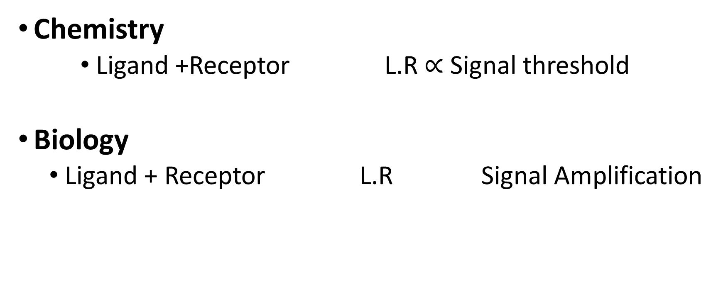
Ligand-Receptor interactions in Chemistry and Biology
Chemistry
Ligand +Receptor L.R $∝$ Signal threshold
Biology
Ligand + Receptor L.R Signal Amplification

Slide 18
Importance of signal amplification
K_{d} Value for Insulin and Insulin Receptor is 10⁻⁷ M
Physiological Concentration of Insulin is 10⁻⁹ M
After a meal Insulin Concentration goes up to 10⁻⁸ M
Even with approximately 11 % receptor occupancy, our body achieves normal glucose levels

Slide 19
Signal amplification pathways
Phosphorylation cascades
Generation of second messengers
cAMP-pathway
Diacyl glycerol and inositol 1,4,5 trisphosphates, Calcium ions

Slide 20
Signal responses
Nucleus
Activation of gene transcription
Inhibition of gene transcription
Cytoplasm
Modification of protein activity
Increase of an enzyme activity
Inhibition of enzyme activity
Alteration in sub-cellular distribution of proteins

Slide 21
Protein phosphorylation cascades

Slide 22
Phosphorylation cascades – gene regulation

Slide 23
G proteins produce second messenger cAMP

Slide 24
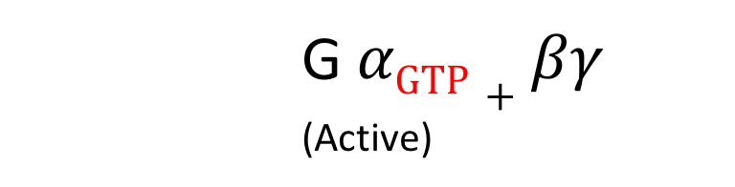
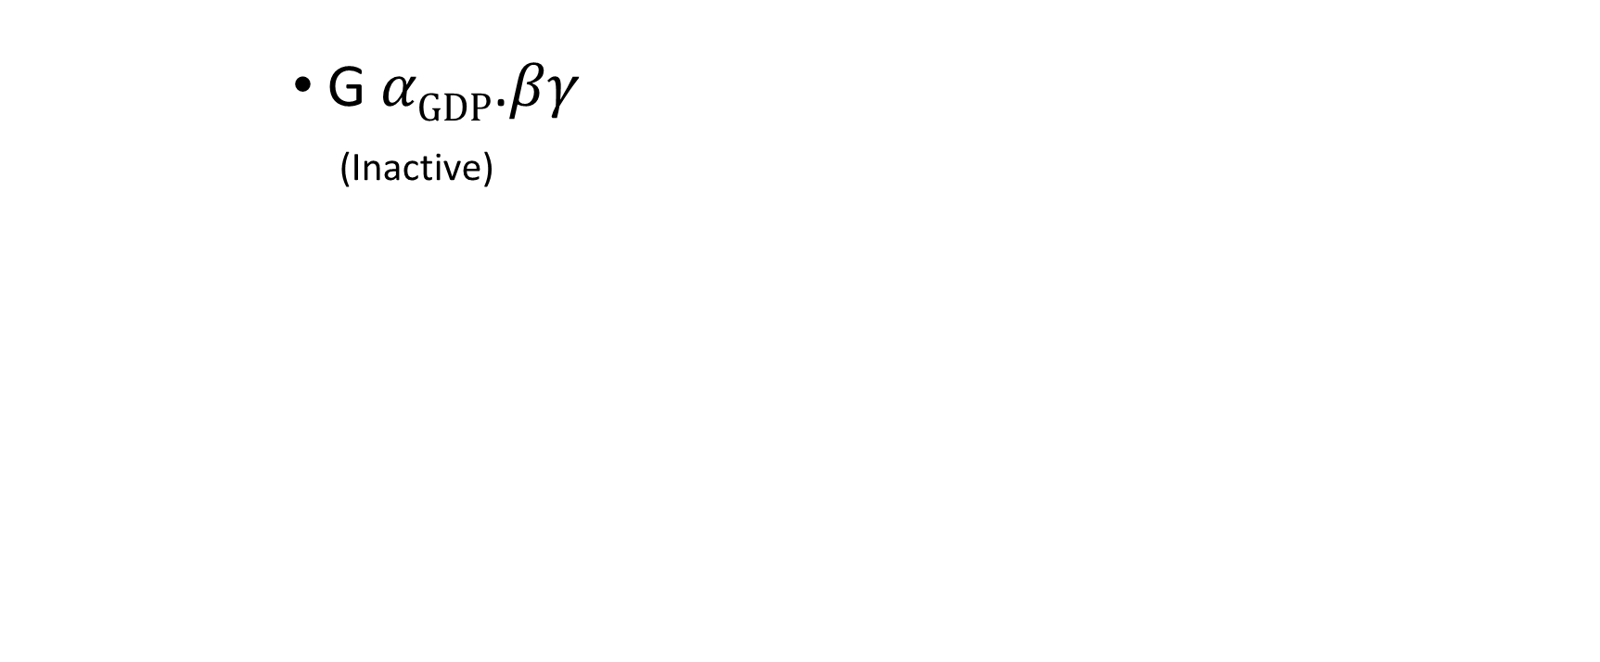
G-Proteins as molecular switches
G $αGDP$.$βγ$
_{(Inactive)}
G $αGTP+βγ$
_{(Active)}
P_{i}
Cholera toxin lock G proteins in GTP bound form

Slide 26
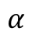
G-proteins can also produce DAG, InsP₃, Ca²⁺
$$α$$

Slide 27
Signal specificity and diversity
A signaling molecule may have
Unique signaling
Branched signaling
Cross signaling with other molecules

Slide 28
Adapter molecules play a role in branched signaling

Slide 29
Regulation of cell signaling
Receptor level
Receptors will be inactivated by other signaling mechanisms
Ex. GPCR are inactivated by arrestin molecules
RTKs are inactivated by Ser / Thr phosphorylation
Tyr phosphatases dephosphorylate phospho-tyrosine residues
Relay molecules level
Multiple relay steps offer regulation at different levels
Second messengers levels
cAMP phospho-diesterases convert cAMP to AMP

Slide 30
Programmed Cell Death Signaling in Development
Important in Development and elimination of defective cells
In Development and immune responses.
It is essential to maintain proper cell numbers. In fighting infections, immune cell numbers increase drastically. After clearing the infectious agent, these cells will be programmed to death by external signals.
Unlike growth signals, the steps involved in PCD are irreversible.

Slide 31
Apoptosis in paw development in mouse

Slide 32
Programmed Cell Death in Defective Cells
Cell will become defective if:
DNA is damaged
Endoplasmic reticulum becomes stressed
In both cases they initiate signaling cascades that breaks down DNA and mitochondria leading to cell death (death is in individual cells).
PCD is mediated by proteases known as Caspases.

